Slide 1

Effective Stroke Technique

Slide 2
Streamlining

Slide 3
Streamlining(Points to Get Over to the Group)
Poor skills in starting/turning/transfer to stroke will put you at a disadvantage to other swimmers in the race who have superior skills.
The older you become improvements become minimal, superior streamlining skills and transfer to stroke ability off starts and turns, should be addressed early in the training programme.
Underwater transfer to stroke capabilities need to be of the highest standard.

Slide 4
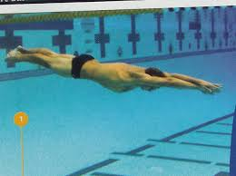
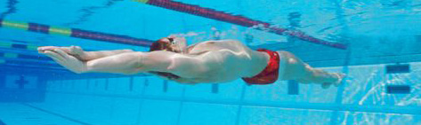
Streamlining Points
(To Get Over To the Group)
Most Olympic Champions swim with less strokes than their competitors
Most are more streamlined within the actual swimming stroke for longer
Great 200 metre Breaststroke swimmers have their arms in a streamlined position almost half the entire race
Many are better both around the wall and off the wall
Streamlining is very important to both technique and transition skills.

Slide 5
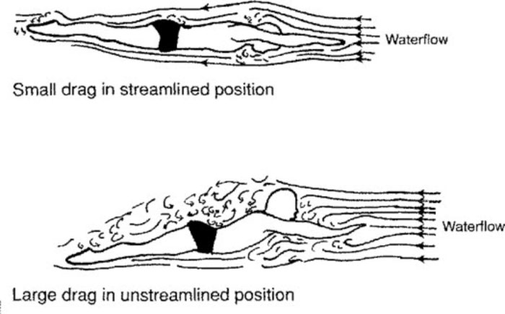
What is Streamline ?
A shape that presents very little resistance to a flow of water, giving increased speed and ease of movement through the water.
A line along which the flow
of a moving fluid is least turbulent.
Less Drag gives increased speed
Effective streamlining with dolphin kick is faster and more energy efficient than swimming on top of the water.

Slide 6

Perfect Streamline
Teach streamline focus on tension through the Red Dots/Joints
Ankles - Knees – hips-
Shoulders - Neck -
Elbows - Wrist
Apply strength in these areas
Maintain flexibility

Slide 7
Transition To Stroke

Slide 8
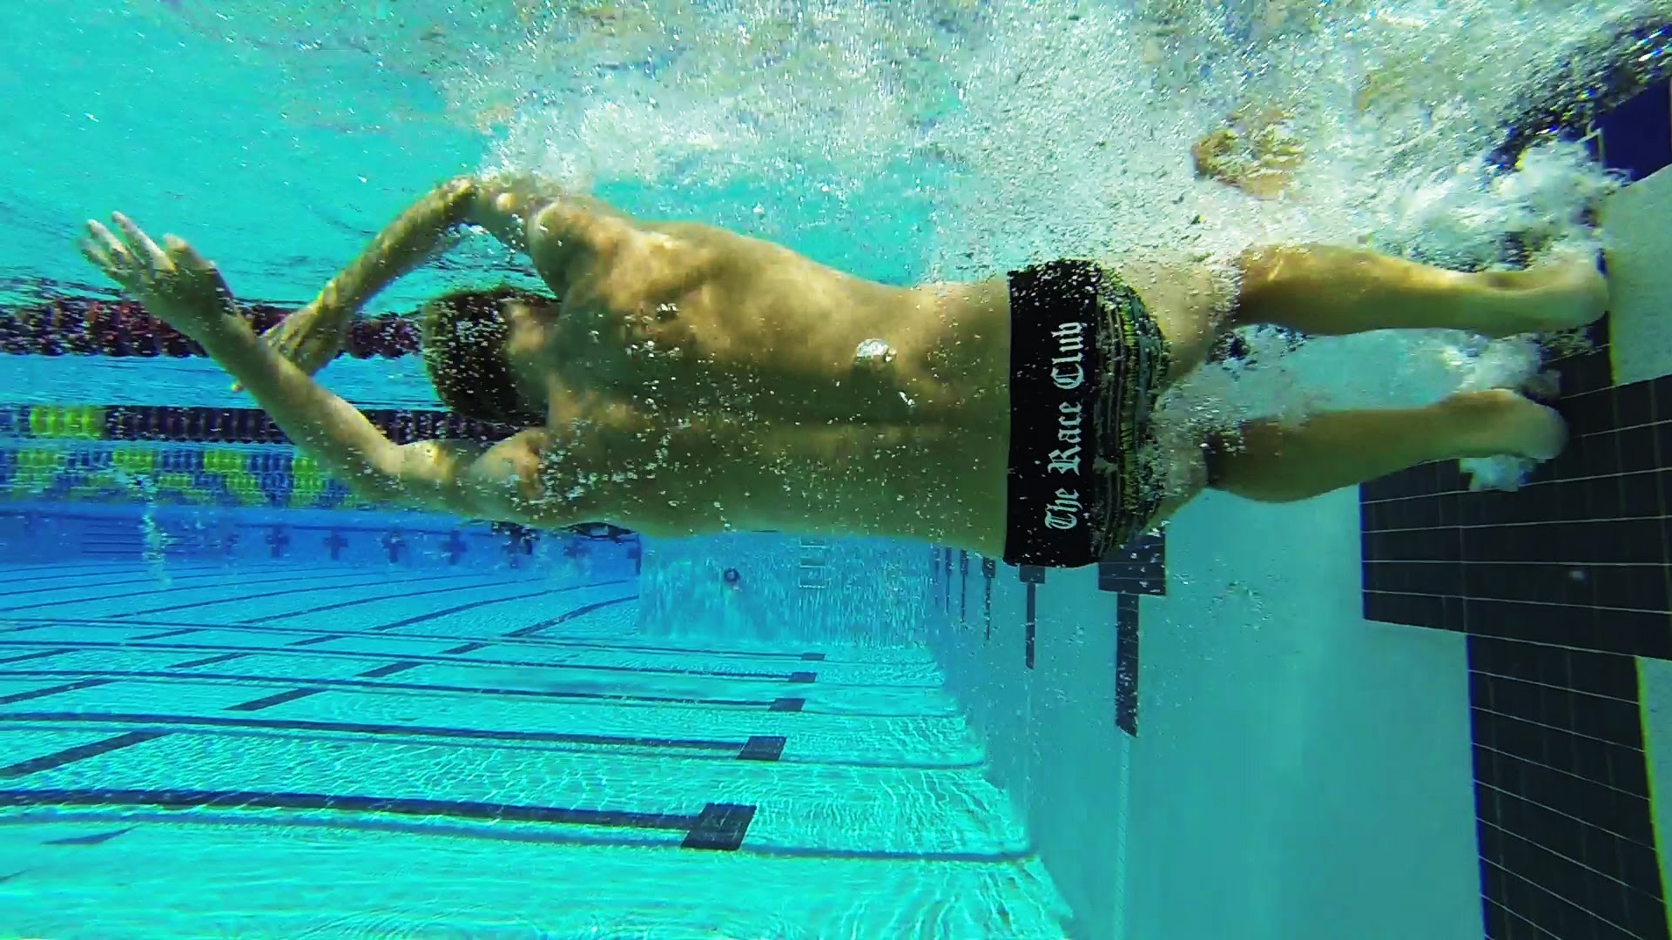
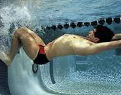
Transition To Stroke
Push Off Technique
Coach/teach correct push offs
Sink and push
Body position, arm action important when sinking
Hips and shoulder alignment
Arms ¾ streamline as push is made
Leave the wall on side
Rotate to prone ‘off the wall not ‘on the wall
Natural lift will occur from air in the lungs
Hands Meet before Push Off
Feet on wall/whilst facing side
Hips Shoulders In Line
Streamline is reached before toes leave wall

Slide 9
Breakout – Transition from UW to Surface
Aim is to transfer underwater push and speed into swimming speed
Remain as horizontal as possible from UW to breaking surface of water
Low skilled/young age groupers search for big breath here following submersion
First pull down close to the surface so that momentum is picked up instantly
Starting pull to early will result in drag as body not in streamlined position
Keep head position neutral
Shoulders and head break the surface together on Fly/Back/Free

Slide 10
Breaststroke UW Breakout
More depth required an efficient breakout will be between
8 -12 mts long
The Breaststroke pull out rules allows 1 double arm pull through to the hips, 1 dolphin kick and 1 breaststroke kick before commencing the stroke.
The dolphin kick can be performed before/during or after the pull down
I prefer an early dolphin kick because it helps maintain push off speed, its easier to maintain streamlining this way, the pull down commences immediately following the down beat, legs must return to streamline as quickly as possible.

Slide 11
Perfect UW Breaststroke Breakout (Points)
Hands and forearms remain tight to chest and head through recovery
Heels recover to ‘catch’ at speed
Kick must be ready to strike as arms are at ¾ extension, otherwise excessive drag occurs
Arms and legs reach streamline position simultaneously.

Slide 12
Essentials In Technique
Body Position
Legs
Arms
Breathing
Timing
Remember Action/Reaction
Stroke Length/DPS
Stroke Rate
Acceleration
Rotation
Rhythm
Consistency of application
Flexibility and ROM
Overall efficiency

Slide 13
Key Technical Points 4 Strokes

Slide 14
Breaststroke

Slide 15
Key Technical Requirements
Starting point is feet and high degree of ankle flexibility
Very few World Class Breaststrokers are arm dominant
Acceleration through both pull and kick
Timing and streamlining is crucial
Speed is at extension
Breaststroke the most individual of all the strokes

Slide 16
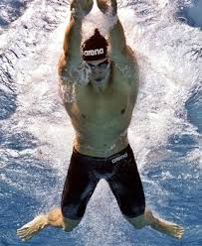
Key teaching/coaching points – Body Position
Will lift in relation to in-sweep of arms and coming together of hands
Will drop as reach forward to full extension
Aim is not excessive undulation
Body at its most streamlined as arms reach full extension and feet are accelerating together
Technically gifted individuals will spend almost half the race in this position
Breathing-breath takes place during in-scull - avoid lifting head too early to breath during the out-scull.

Slide 17
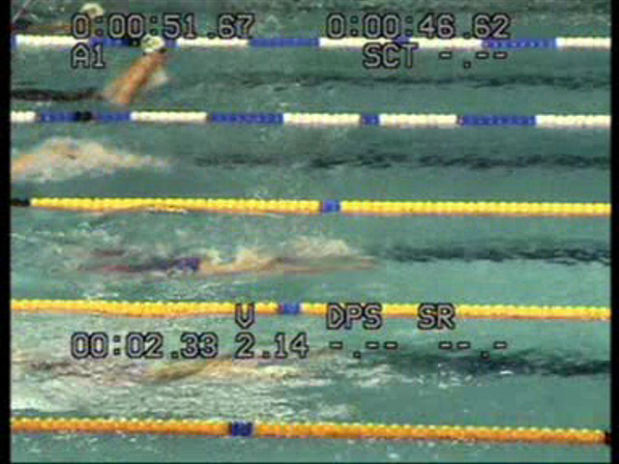
Speed At Extension

Slide 18
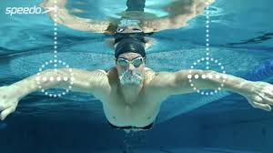
Key teaching/coaching points - Arms
Press outwards at ‘catch’ point
Firm hold on water
Accelerate through the pull and into the in-sweep
Maintain high elbows
Do not pause underneath your chest, extend forward preparing for next ‘catch’ and arm cycle.
Rapid forward movement of arms to extension, this is the fastest part of the stroke

Slide 19
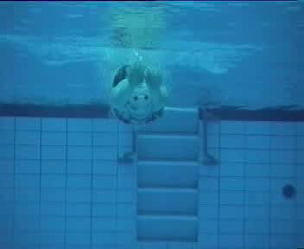
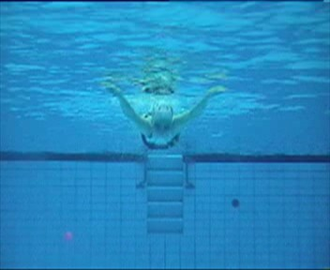

Slide 20
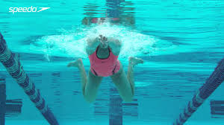
Key teaching/coaching points - Legs
Recover feet within bodyline think feet to hips rather than knees to chest
Take time to position feet to kick effectively
Set feet outwards – flex your ankles
Main force of propulsion from knees down
Kick backwards explosively
Kick completed when feet drive together
Finish kick with fast acceleration and ankle movement/squeeze gluts together at end of kick

Slide 21
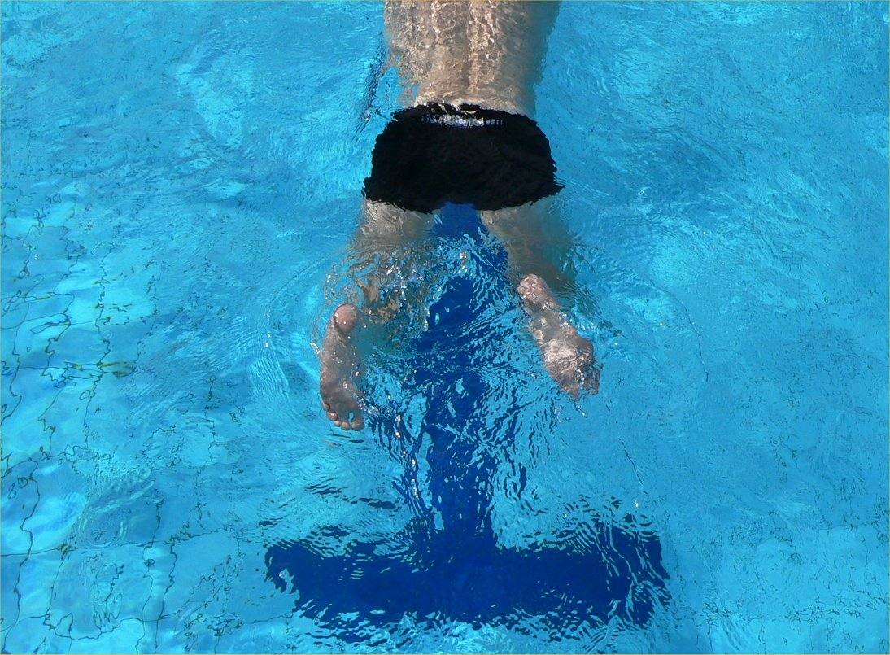
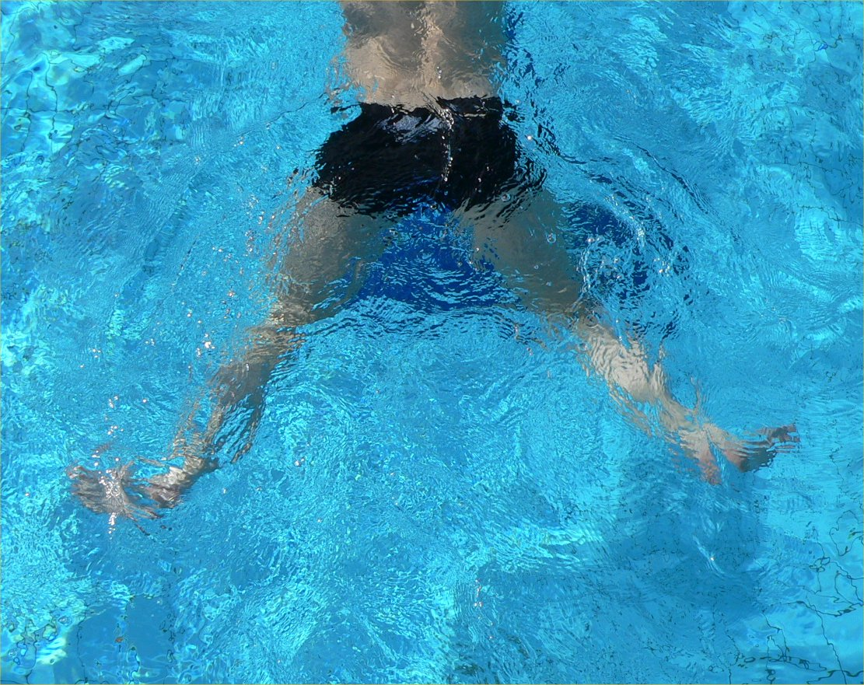

Slide 22
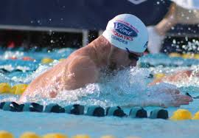
Key teaching/coaching points – Timing/Streamline
Timing of head drop between arms is crucial
Head/Shoulders and back are a unit
Controlled rise and fall through the stroke cycle
Minimise the ‘frontal resistance’
Stay compact
Pull elbows in during the in-sweep
Drop your head through your elbows on the extension forwards.

Slide 23
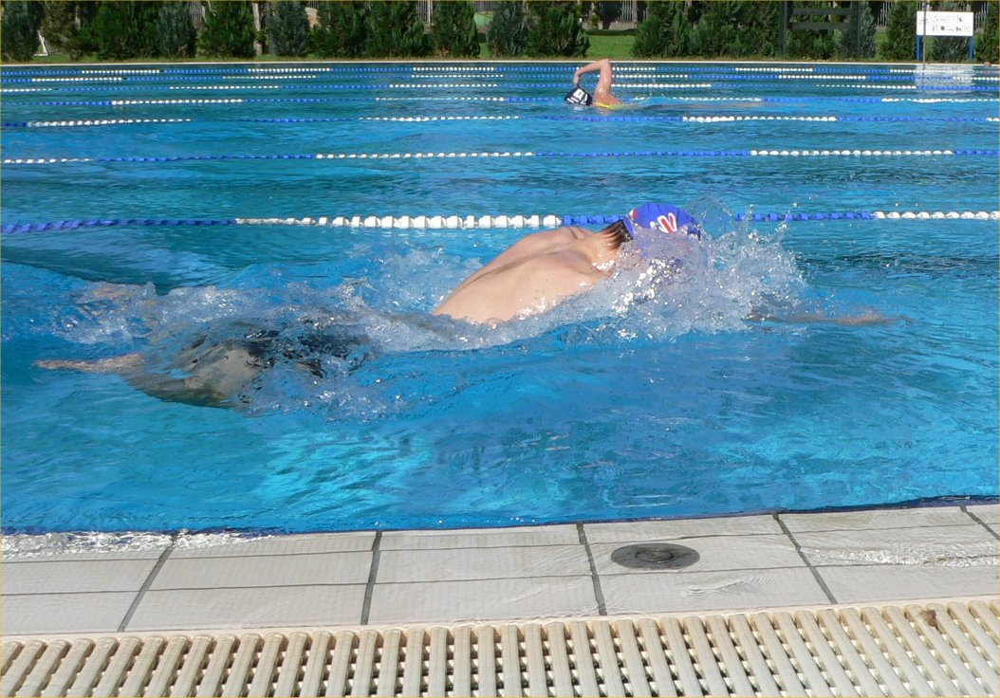
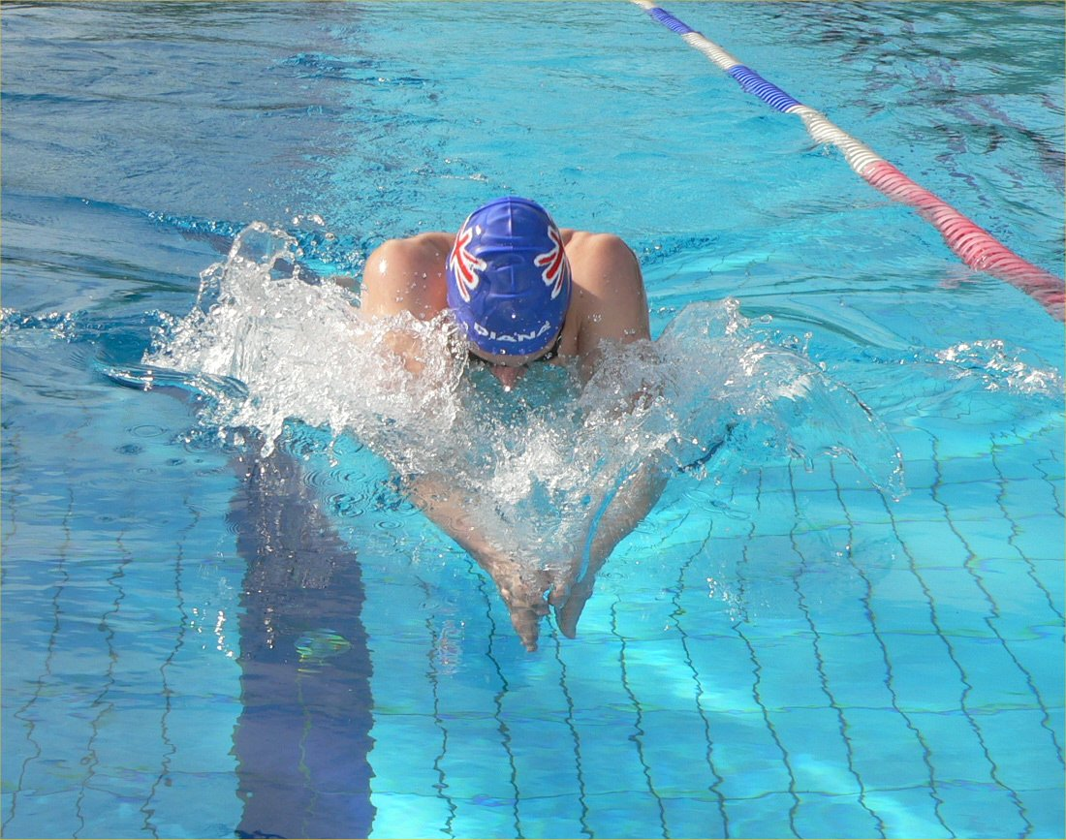

Slide 24
Common Faults - Arms
Palms together at full extension
Cannot ‘catch’ the water in this position, first movement would be to rotate the wrist so that they can press outwards
Will cause to slip water on first part of pull
Rotate the hands through the recovery of the arms.
Hands are now ready for action
Hands can press outwards immediately and start propulsion.

Slide 25
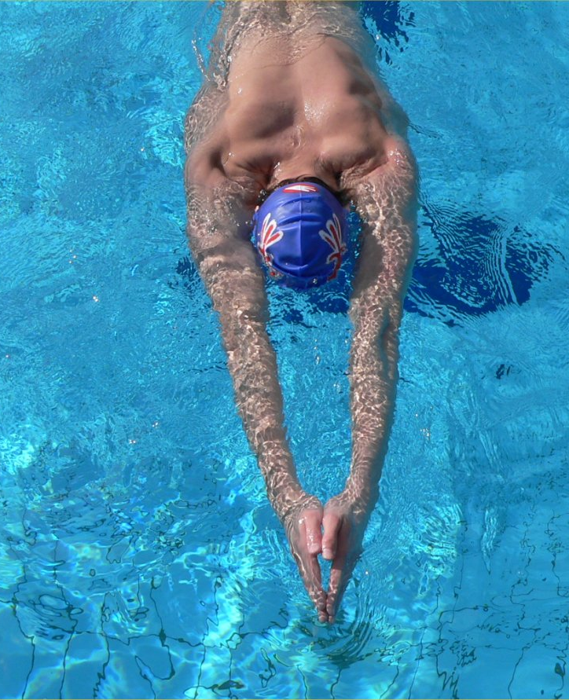
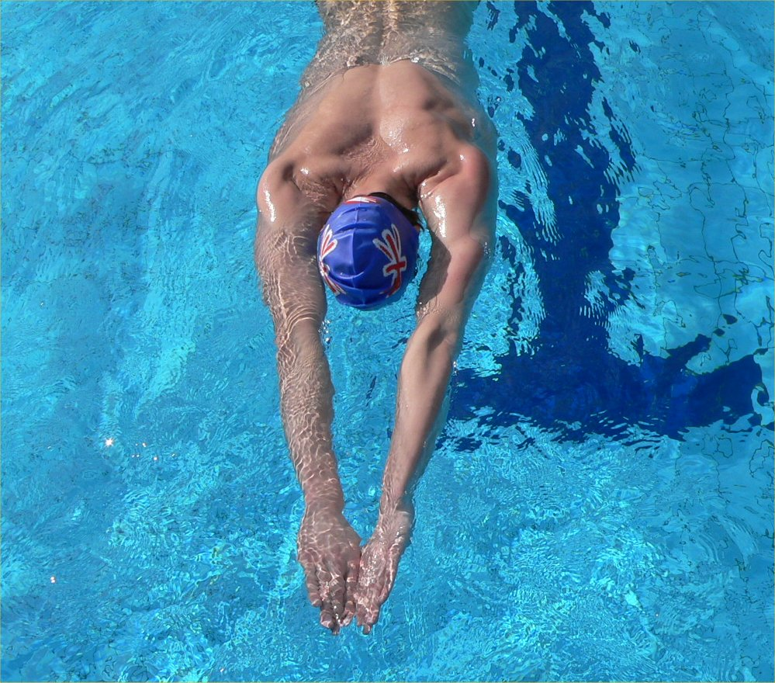

Slide 26
Common Faults - Legs
Propulsive phase only accounts for 10-20% of the kick cycle
This part of the kick will last for less than 0.5 second so it has to be forceful and fast
Make the most from minimising resistance in the recovery phase
Prepare to maximise propulsion, rotate feet outwards, feet in the ‘set’ position
Explode backwards together, accelerate through final part of the kick.

Slide 27
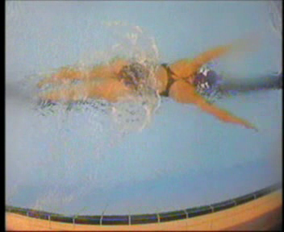
Breaststroke Body Position/Timing

Slide 28
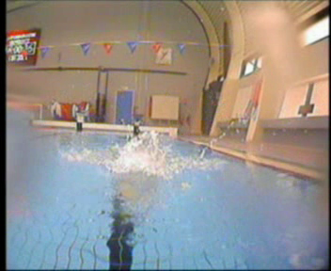
Breast Arm Action/Shoulder Lift

Slide 29
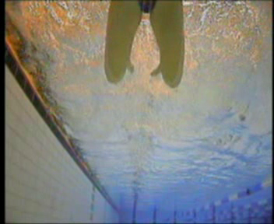
Breast Leg Action

Slide 30
Breaststroke - Key Technique Points
Not excessive undulation/inclination
Look for ability to extend as arms reach for full extension and feet accelerate together
Timing of head drop into stroke
Feel ‘catch’ slightly wider than shoulder width
Outward, slightly downward sweep of arms.
Accelerate hands/arms together/lift of shoulders
Propulsion on kick from knees down/acceleration of feet
Not excessive parting of upper legs
Breathing, takes place on in-scull, avoid early breathing on out-scull
Fastest phase of stroke at full extension

Slide 31
Butterfly

Slide 32
Key Technical Requirements
Combine power and balance within the stroke
Coach head to toe movement wave type action
Hip action essential for effective kick, propulsive finish to the wave.
Target minimum upper body movement, with 2 kicks to each arm cycle.
Relaxed recovery, landing of arms and head must be simultaneous.

Slide 33
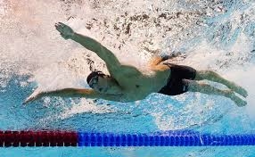
Key teaching/coaching Points
Body Position - Undulation
Keep to a minimum , its a wave like motion, with a fairly flat upper body.
This is important to decrease fatigue build up.
As the chest is pressed down into the water there is relatively little movement through head/chest.
It then increases in strength as it travels through hips and legs finally to feet.
Position of head
Avoid excessive movement of head.
The aim is relaxation in the area of the neck
During breathing the aim should be as little undulation as possible.
Breathing-to requirements of event

Slide 34
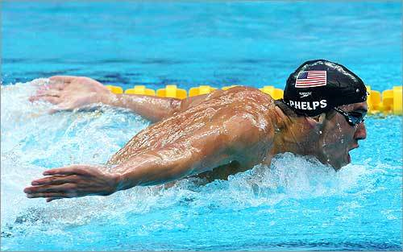


Slide 35
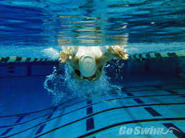
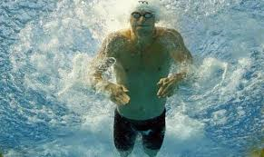
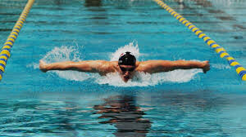
Key teaching/coaching points - Arms
Enter on shoulder line
Head low at hand entry point
Limited head lift through breathing
Propulsive phase consist of out-sweep, in-sweep and back-sweep , accelerate hands past thighs
Return head down as arms pass the line of shoulders, this will bring hips up to body into alignment
Low flinging recovery with elbows flexed hands low to water

Slide 36
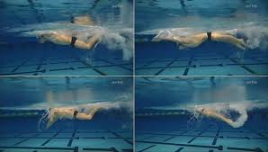
Key teaching/coaching points - Legs
On down-beat, whip motion begins with flexion of the hips initiated by the core of the body
Accelerate through to feet
Drive feet back below line of the hips
Slight knee bend on down kick
In-toeing of feet

Slide 37
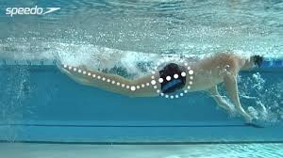

Slide 38
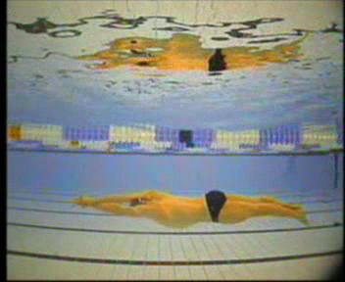
Butterfly Body Position

Slide 39
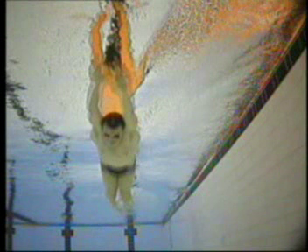
Butterfly Arm Action/Breathing

Slide 40
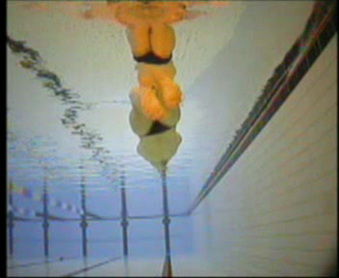
Butterfly Leg Kick

Slide 41
Butterfly - Key Technique Points
Not excessive undulation (body wave) (skim across the water)
Timing of head lift/drop through breathing
Low flinging arm recovery with elbows slightly flexed
On underwater arm phase accelerate downwards , outwards, backwards movement with acceleration to aid the recovery
Hand entry point between shoulder line and middle of head.
Kick from hips
Slight bend of knee, in-toeing of feet
2 kicks to 1 arm cycle
Kick 1 on entry, kick 2 on release
Breathing pattern to suit event requirements

Slide 42
Frontcrawl

Slide 43
Key Technical Requirements
Importance of Streamline Positions
Swim in two straight lines
1) Horizontal
2) Vertical
Reduction of any Lateral deviation
1) Importance of kick efficiency
2) Importance of stable head position
3) Importance of shoulder ROM
Hip and Shoulder Rotation
1) Hips 45 degrees each side
2) Shoulders more than hips
Learn to develop use of both internal and external rotator muscles groups to produce power and relaxation at key stages of arm stroke

Slide 44
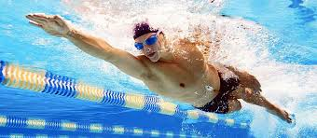
Frontcrawl Shoulder/Hip Rotation
Slide Hand to ‘Catch’ Position

Slide 45
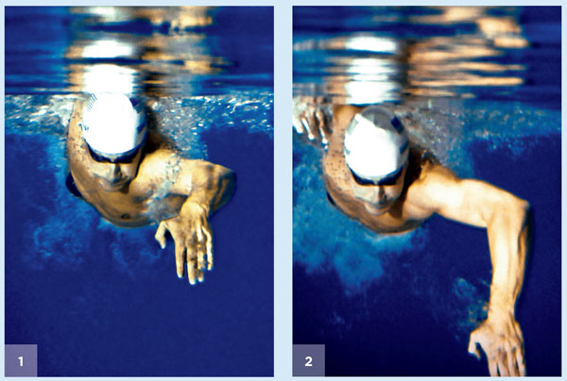
Frontcrawl Transfer From ‘Catch’ To High Elbow Position

Slide 46
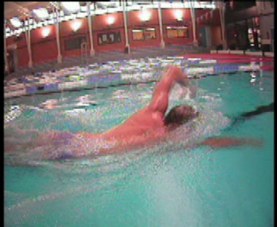
Body Position/Rotation/Breathing

Slide 47
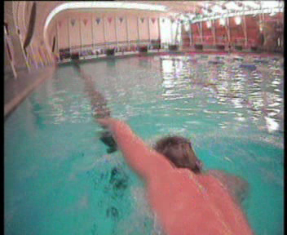
Relaxed High Elbow Recovery/Shoulder-Hip Rotation

Slide 48
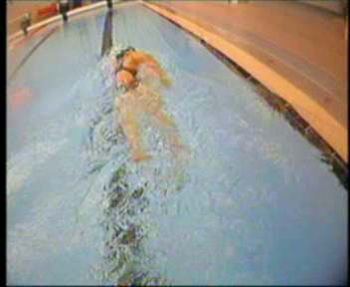
Leg Action

Slide 49
Front crawl Key Technique Points
Rotation of body through longitudinal axis to facilitate DPS , catch and breathing.
When not breathing look about 1 metre in front
High relaxed elbow recovery.
DPS on hand entry with wrist above hand
High elbow pull approximately 100/110 degrees for maximum propulsion
Accelerate to push phase
Slow to fast hand speed from entry to release
Kick originates from hips
Some crossover of feet
Breathing/timing in relation to event

Slide 50
Backstroke

Slide 51
Key Technical Requirements
The nature of the stroke demands that balance ,rhythm, relaxation and controlled rotation are key to good technique.
Timing of rotation is important to keep the stroke flowing and maintain balance
Build a strong core strength programme to maximise underwater skill off the wall
Important to hold SR throughout the race, this is a common fault particularly when swimming 200 BK
Have the ability to maximise underwater transition from the start and turns, accelerate into first stroke at the surface.
Rate of underwater kick is crucial to maintain momentum and speed off the wall
Both BK and Fly kick sets are vital part of training for this stroke.

Slide 52
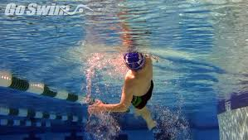
Back Pull Shoulder/Hip Rotation

Slide 53
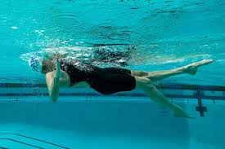
Back Pull Underwater Elbow High

Slide 54
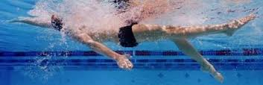
Accelerate Through To Push Phase

Slide 55
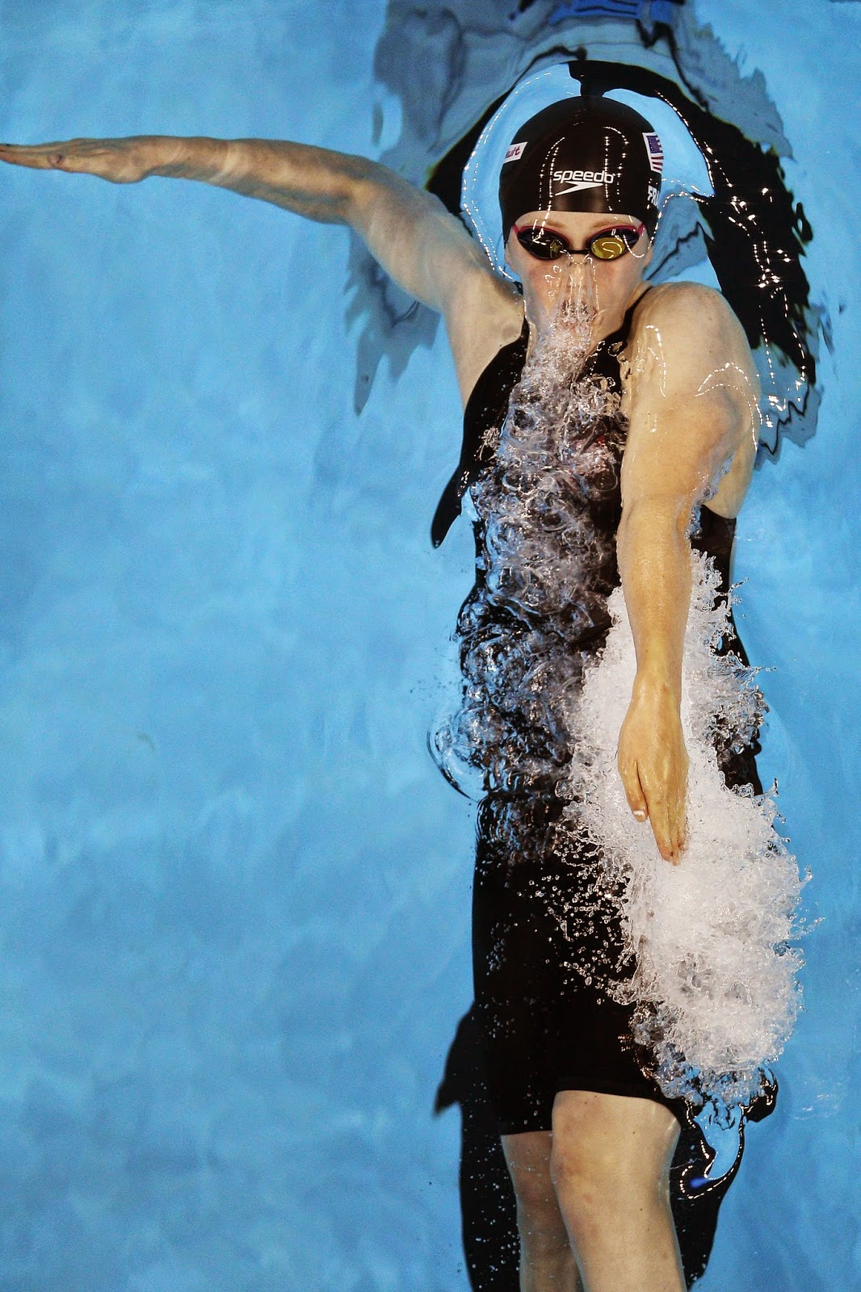

Slide 56
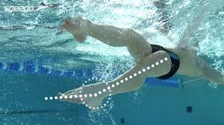
Back Kick Depth/Ankle Flexibility

Slide 57
Back – Body Position/Rotation

Slide 58
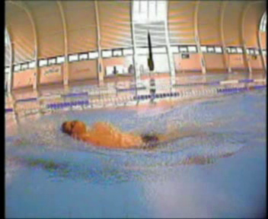
Back –Head Position/Shoulder-Hip Rotation

Slide 59
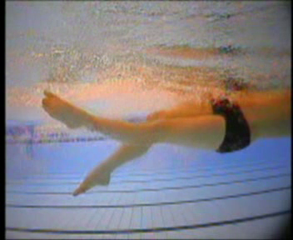
Back – Leg Action

Slide 60
Backstroke Key Technique Points
Slight incline in body position to accommodate head position.
Fixed head position throughout stroke cycle.
Rotation of body through hips and shoulders
Relaxed little finger entry
High elbow pull, accelerate through to push phase
Hand finishes below body line.
Thumb first recovery turning to little finger first entry
Continuous kick from hips
Slight in-toeing of feet
Propulsion on up-kick

